Slide 1

UNIVERSITY INSTITUTE OF SCIENCES
Academic Unit V
Bachelor of Engineering
(Computer Science & Engineering)
Biology For Engineers
23SZT-148
Sensors/ receptors in the human body
Chemoreceptor: hot and cold receptors, sensors for smell, sound, vision
DISCOVER . LEARN . EMPOWER

Slide 2
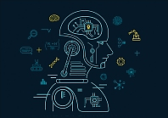

Course Outcome
CO Number | Title | Level
CO1 | Identify the biological concepts from an engineering perspective. | Remember
CO2 | Development of artificial systems mimicking human action. | Understand
CO3 | Explain the basic of genetics that helps to identify and formulate problems | Understand
CO4 | Apply knowledge of measurement system, biomedical recording system and biosensors to excel in areas such as entrepreneurship, medicine, government, and education. | Understand
CO5 | Integrate biological principles for developing next generation technologies
Will be covered in this lecture
https://images.app.goo.gl/5obqqxo93P2UBmdU6

Slide 3
SYLLABUS
Unit-2 | Biosensors and measurement system | Contact Hours: 15
Chapter 1 Medical Instrumentation Chapter 2 Measurement System Chapter 3 Biological Sensor | Medical Instrumentation: Sources of biomedical Signals, Basic medical Instrumentation system, Performance requirements of medical Instrumentation System, Microprocessors in Medical instruments, PC base medical Instruments, General constraints in the design of medical Instrumentation system, Regulation of Medical Devices. Measurement System: Specification of instruments, Statics & Dynamic characteristics of medical instruments, Classification of errors. Statistical analysis, Reliability, Accuracy, Fidelity, Speed of responses, Linearization of technique, and Data Acquisition System. Biological sensors: Sensors/ receptors in the human body, basic organization of the nervous system- neural mechanism, Chemoreceptor: hot and cold receptors, sensors for smell, sound, vision, Ion exchange membrane electrodes, enzyme, glucose sensors, immunosensors, & biosensors & applications of biosensors.

Slide 4
Biological Sensors
Sensors/ receptors in the human body
Chemoreceptor: sensors for smell and taste
Photoreceptor: vision
Mechanoreceptor: hot and cold receptors, sound

Slide 5
What are sensory receptors?
Structures that are specialized to respond to the changes (stimuli) in the environment.
Sensory receptors in periphery detects the stimuli.

Slide 6
WHAT IS SENSOR?
A sensor is a converter that measures a physical quantity and converts it into a signal which can be read by an observer or by an instrument.

Slide 7
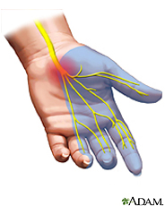
What is a sensor?
A sensor is a device that measures a physical quantity.
Example: When you touch an object, sensors on your fingers send signals to your brain so that it measures temperature, and so your brain recognizes the object as being hot or cold.
The skin in your fingers contains millions of sensitive nerve endings that can detect stimuli (physical quantities) such as temperature.
This stimulus is converted to neuronal impulses that are sent via nerves to a specific region in the brain, which interprets it as being hot or cold.
The same happens with pressure and pain signals.
Notes:
Sensing is all about measuring physical quantities and interpreting these measurements in order to draw conclusions.

Slide 8
What are Receptors?
Receptors are biological transducers that convert energy from both external and internal environments into electrical impulses.

Slide 9
What is a transducer?
A sensor is a device that senses or detects a signal.
Signals are forms of energy, and a sensor senses a signal by typically converting one form of energy to another.
This act of converting is also called transducing, and so sensors are also called transducers.
➔ So, a transducer is a device that converts one signal to another.
Examples: A microphone converts sound to electricity, a car speedometer converts wheel rotation to a speed reading. These signals are sent to the computer (or the brain).
➔ So, a sensor is also called a transducer.
Physics and engineering concepts are used to develop a variety of transducers. For instance, a type of pressure sensor converts strain (stretch) into an electrical signal.

Slide 10
Sensory Receptors
The human body can achieve an understanding of the world through its Sensory/Receptor systems.
A major role of sensory receptors is to help us learn about the environment around us, or about the state of our internal environment.
Different types of stimuli from varying sources are received and changed into the electrochemical signals of the nervous system.
This process is called sensory transduction.

Slide 11
How Sensory Receptor systems works?
Sensory/receptors massed together to form a sense organ, such as the eye or ear, or they may be scattered, as are those of the skin and viscera.
When a stimulus is detected by a receptor which generates a graded potential in a sensory neuron.
Receptors are connected to the central nervous system by afferent nerve fibers.
If strong enough, the graded potential causes the sensory neuron to produce an action potential that is relayed into the central nervous system (CNS), where it is integrated with other sensory information—and sometimes higher cognitive functions—to become a conscious perception of that stimulus.
The central integration may then lead to a motor response.
Example: When you touch an object, sensors on your fingers send signals to your brain so that it measures temperature, and so your brain recognizes the object as being hot or cold.
Notes:
Viscera: the large internal organs in the body, such as the heart, lungs and stomach

Slide 12
Sensors provide information to make decisions: from stimulus to response
stimulus > sensor > coordinator > effector > response
touch > pain receptor > nervous system > muscle > movement
The sequence of steps above describes what happens when you touch something hot—the stimulus is touch, the sensor is the temperature receptor on your finger that senses it and relays it to the nervous system (spinal cord and brain), which is the coordinator.
The coordinator makes the decision of how to react, and then commands the hand muscles (the effector) to jerk back quickly.
In summary: We go from stimulus (touch) to response (movement of hand).
Notes:
Sensing is all about measuring physical quantities and interpreting these measurements in order to draw conclusions.

Slide 13
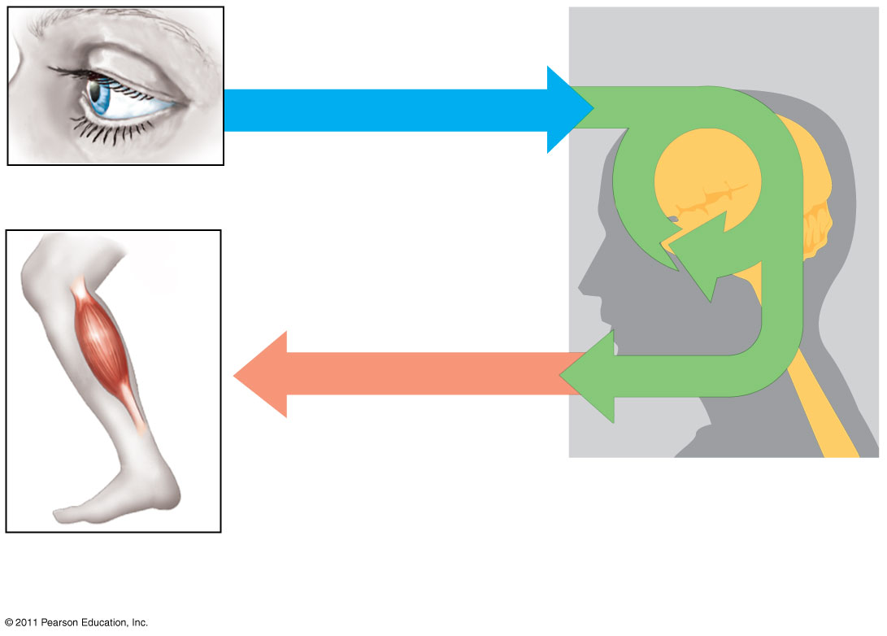
Sensory input
Sensor
Integration
Motor output
Effector
Peripheral nervous system (PNS)
Central nervous system (CNS)
Notes:
Summary of information processing

Slide 14
Sensory Input
Sensors:
Detect Changes in environmental conditions
Use Receptor Cells
Transduction
Conversion of environmental change into an electrical signal
Receptor responds to stimulus by releasing neurotransmitter to a neuron
Neuron sends message to brain to be interpreted

Slide 15
Sensation
Humans can perceive various types of sensations, and with this information, our motor movement is determined.
We become aware of the world by way of sensation.
Sensations can also be protective to the body, by registering environmental cold or warm, and painful needle prick, for example.
From the soft touch of the child to the painful punch of a boxer, all the daily activities carry associations with sensations.
Sensation refers to our ability to detect or sense the physical qualities of our environment
Broadly, these sensations can classify into two categories.
First, general sensations which include touch, pain, temperature, proprioception, and pressure.
Vision, hearing, taste, and smell are special senses which convey sensations to the brain through cranial nerves

Slide 16
Sensation must meet four conditions:
Characteristics of Sensations
Stimulus or change in environment, activate certain sensory neurons
Form of light, heat, pressure, mechanical energy, or chemical energy
Sensory receptor must convert stimulus to electrical signal which produces one or more nerve impulses if it is large enough
Nerve impulses must be conducted along a neural pathway from sensory receptor to brain
Region of brain must receive and integrate nerve impulses into a sensation
Perceptions: conscious sensation
“Eyes see”; specialized sensory neurons integrated in cerebral cortex where they are interpreted
Sensation is to awareness, as perception is to interpretation.
Adaptation: a decrease in strength of a sensation due to prolonged stimulus which may lead to perceptions fading or disappearing even though stimulus persists.

Slide 17
Classification of Receptors
By the mechanism of excitation
Primary and secondary sensitive
By the location in the body
External, internal, proprioceptor
By the nature of the stimulus
Mechanical, chemical, baro-, thermo-
By the nature of caused sensations
Visual, olfactory, gustatory, auditory
By the distance from the stimulus
Contact, distant
By the velocity of adaptation
Slow adaptive, quickly adaptive, non-adaptive
Dendritic endings of sensory neurons:
Free ending
Pain
Temperature
Encapsulated
Pressure
Touch
Rods and cones
Sight
Modified epithelial cells
Taste buds

Slide 18
Human Sensors
Your sensory organs (eyes, ears, nose and skin) provide information to your brain so that it can make decisions. They work in a manner similar to the working of robot sensors.
Your brain continuously uses the information that it receives from your sensory organs to make your body function.
Five main human senses:
Your eyes allow you to see the world
Your ears allow you to hear sounds
Your skin lets you feel objects through touch
Your nose lets you smell the many scents in the world
Your tongue lets you taste
Plus additional sensors in our bodies that you do not notice directly:
Sensors in the inner ear give the brain information about balance
Sensors in muscles let the brain know body position
Sensors throughout the body that detect temperature
and others…

Slide 19
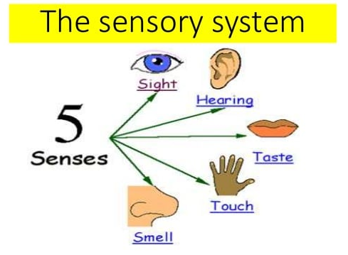
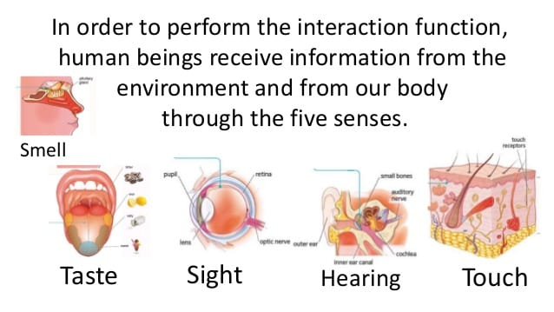
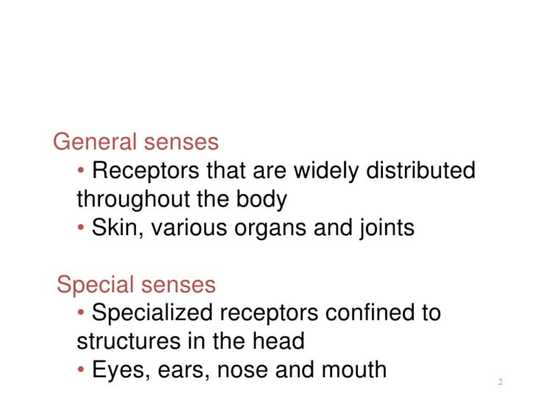
Sensory Organs:
Window of the brain

Slide 20
Sensory Receptors
Sensory systems are widespread throughout the body including those that detect the world directly from the outside (exteroreceptors), those that detect information from internal organs and processes (interoceptors), and those detecting sense of position and load (proprioception).
Sensory receptors occur in specialized organs such as the eyes, ears, nose, and mouth, as well as internal organs.
Each receptor type conveys a distinct sensory modality to integrate into a single perceptual frame eventually.
This information is achieved by the conversion of energy into an electrical signal by specialized mechanisms.

Slide 21
Types of Environmental Stimuli
Chemoreception
Photoreception
Mechanoreception

Slide 22
Chemoreception
Detection of chemical types and concentrations
Receptors for chemoreception are called Chemoreceptors
Types of chemoreceptors:
1. Taste Receptors
– Detects chemicals dissolved in water within the mouth
2. Smell- Olfactory Receptors
– Sense chemicals in the air
3. Osmoreceptors
An osmoreceptor is a sensory receptor primarily found in the hypothalamus of most homeothermic organisms that detects changes in osmotic pressure.
Osmoreceptors can be found in several structures, including two of the circumventricular organs – the vascular organ of the lamina terminalis, and the subfornical organ.

Slide 23
CHEMORECEPTORS
A chemoreceptor, also known as chemosensor, is a specialized sensory receptor cell which transduces a chemical substance to generate a biological signal.
This signal may be in the form of an action potential, if the chemoreceptor is a neuron, or in the form of a neurotransmitter that can activate a nerve fiber if the chemoreceptor is a specialized cell, such as taste receptors, or an internal peripheral chemoreceptor, such as the carotid bodies.

Slide 24
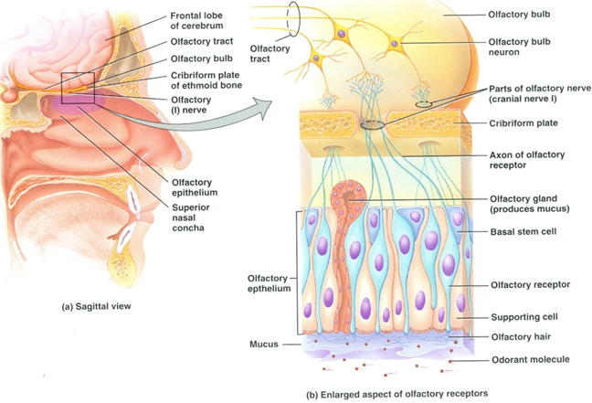
Olfactory Receptors (Distance Receptors)
The organ of smell is the olfactory organ
Detects/Responds chemicals in the air
Olfactory receptors are located in the nose
Consists of nerve cells that have tiny hairs on the surface
Stimulated by odorants; inhaled chemicals
Signals are transferred to the first-order neuron of olfactory pathway
Animal
Breathes
Olfactory receptors respond to molecules
Impulse fired and sent to the brain for interpretation

Slide 25
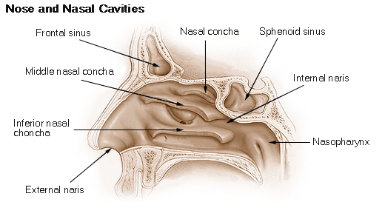
Smell: How do we smell using our noses?
Small particles of almost everything around us can be found in the air.
These particles enter the nose when you breathe in and contact nerve endings in the upper nasal passage.
The nerve endings send signals through the nervous system to the brain, which identifies the smell.
Humans can distinguish between hundreds of different smells.
Dogs can distinguish between thousands.

Slide 26
Smell: How many sensors do our noses have?
The roof of the nasal cavity has olfactory epithelium at the back.
The olfactory epithelium (about the size of a quarter) contains special receptors that are sensitive to odor molecules that travel through the air.
These receptors/neurons are very small. At least 10 million of them are in your nose!
These neurons respond differently to different odors, and the signals are sent via to the olfactory nerve to the olfactory bulb, which is in front of your brain, just above the nasal cavity.
Signals are sent from the olfactory bulb to other parts of the brain to be interpreted as a smell you may recognize.
Humans can distinguish between 10,000 different smells! Dogs have a much better sense of smell than humans. This is because they have 220 million smell receptors, and their olfactory epithelium is about the size of a saucer!
The neurons in your nose convert/transduce the smell into electrical impulses, and send them along the olfactory nerve and olfactory bulb (similar to wires) to various parts of your brain.

Slide 27
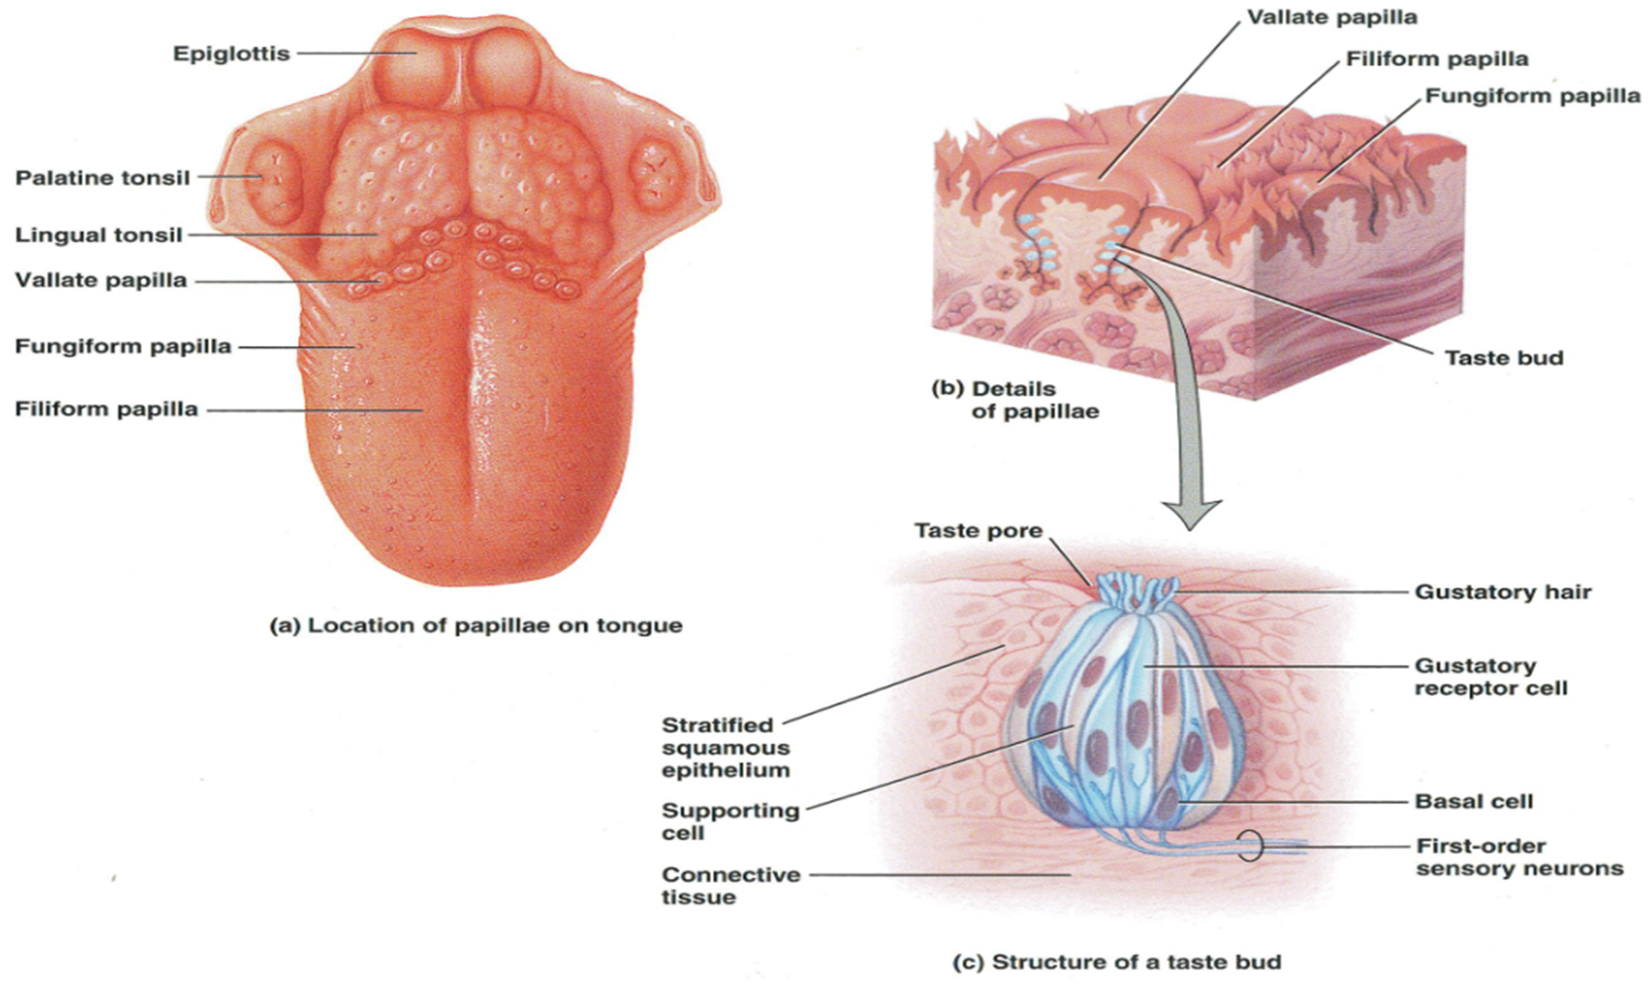
Taste Receptors (Taste Buds)
GUSTATION: SENSE OF TASTE
Allows to detect and identify dissolved chemicals
Chemicals known as tastants stimulate them
Pits found on upper surface of the tongue consist of sensory cells (taste buds)
Every sensory/receptor cell has a tiny hair called a gustatory hair/microvilli, that project into the saliva

Slide 28
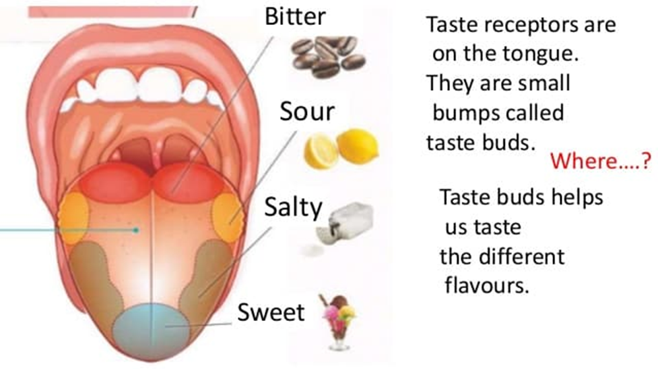
Taste: How do we taste using our tongues?
The tongue has sensory receptors called taste buds present all over the tongue, which can detect 5 different flavors: sweet, salty, bitter, sour, umami
The umami flavor is present in many protein foods, such as meats, cheeses, tomatoes, and mushrooms, and is generally described as a savory, meaty taste.
Taste buds are comprised of gustatory receptor cells that have tiny hairs that detect taste from the food you eat.
The hairs send information to the cells, which send signals through the nervous system to the brain, which interprets the information as taste.
What is the difference between taste and flavor?
Flavor includes taste, but also a little more. It comprises taste, smell, texture, and other sensations such as pain from spicy food.
Eating food with your nose blocked shows decreases its flavor, even though the taste is the same

Slide 29
Taste: How many sensors do our tongues have?
Taste receptors are complicated, and scientists are continuing to investigate to completely understand our tongues.
We know that we can sense five different types of tastes—sweet, salty, bitter, sour and umami—but it is not clear how our tongue distinguishes between them.
It is believed that we have about 50 to 100 receptor cells per taste.
The olfactory bulb integrates inputs from all the receptor cells, and then sends the information to the brain.
The receptors on a human tongue convert/transduce taste into electrical impulses, and send them along the olfactory nerve to the olfactory bulb and various parts of the brain.

Slide 30
Taste Buds: Respond to any one of five primary tastes: sweet, sour, bitter, salty, or umami (savory, glutamate detection)
Gustatory Receptors: Electrical signal stimulate release of neurotransmitter molecules that bind to gustatory receptors on dendrites of taste buds’ first-order neurons
Sensory Nerves: send messages along to the brain
Food Particles: Chemicals come into contact with the gustatory hair receptors
Flavors are then interpreted by brain

Slide 31
Osmoreceptors
Peripheral chemoreceptors located in the heart convey messages to the central nervous system about chemical levels in the blood, including oxygen and carbon dioxide.
Central chemoreceptors, located in the respiratory center at the base of your brain, monitor the levels of carbon dioxide and oxygen by detecting changes in the pH levels of the cerebral spinal fluid.
If, for example, your oxygen levels are too low, your central and peripheral chemoreceptors convey a message that triggers an increase in respiration.

Slide 32
Photoreception (VISION)
Perception of electromagnetic radiation
Animals are only able to use the visible portion (400-700 nm) of the electromagnetic spectrum
Reception of visual signals
Light enters the eye
Specialized cells, photoreceptors, stimulated by particles of light
Three layers: Photoreceptor layer, bipolar cell layer, and ganglion cell layer
Two types of cells in photoreceptor layer:
Rods (allow us to see shades of gray in dim light, like moonlight)
Cones (stimulated by brighter light- highly acute, color vision)
Stimulation of photoreceptors
Photopigment absorbs light ; undergo change in structure to adjust to amount of light available
Color perception: Brain compares outputs of different photoreceptor types.

Slide 33
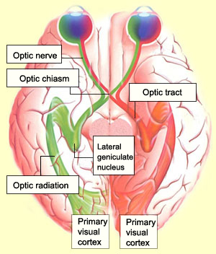
Vision: How does the brain understand what we see?
Light (stimulus) from the object enters the eye.
Light sensors convert (transduce) light into an electrical signal.
This electrical signal passes through the optic nerve to the lateral geniculate nucleus (LGN), which relays the information to the visual cortex.
The visual cortex processes this information and “recognizes” the object seen.

Slide 34
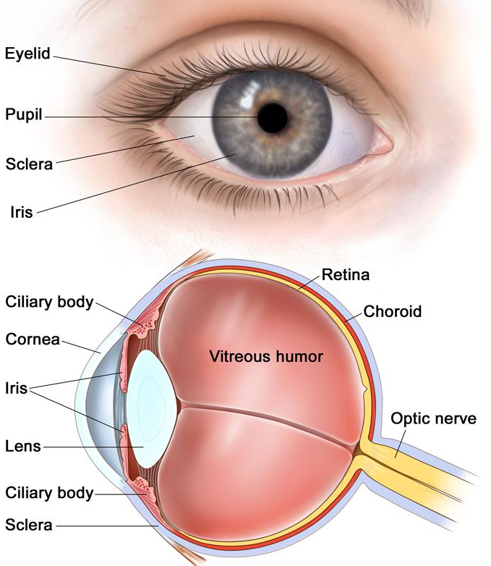
Vision: How do your eyes work?
Light enters the eye, and is refracted (bent) by the cornea, the outermost part of the eye.
Refracted light is directed to the pupil, a small hole in the center of the iris, the colored part of the eye.
The iris changes the pupil size to allow more or less light to enter.
Light that goes through the pupil is redirected again by the eye’s lens, which points the light at nerve cells in the back of the eye.
Two types of nerve cells in the back of the eye:
Cones detect colors and fine details in good light.
They are concentrated in the center back of the eye.
Rods detect the presence of objects in poor light
They are concentrated on the sides of the back part of the eye.
Cones and rods send signals through the optic nerve to the brain.

Slide 35
Vision: How many light sensors do we have?
The cells in your eye that respond to light (that is, the sensors themselves) are called rods and cones.
Rods cannot distinguish colors, but are responsible for low-light black-and-white vision.
Cones are responsible for color vision.
Millions of rods and cones are present in each of your eyes, and they send their signals to the visual cortex of your brain.
The visual cortex integrates the signals from the rods and cones and assembles the “picture” of the object in your brain, similar to how a camera assembles the various bits of an object into a picture of the entire object.
The rods and cones convert/transduce light energy into electrical energy, and send the energy along the optic nerve (similar to wires) to the visual cortex of your brain.

Slide 36
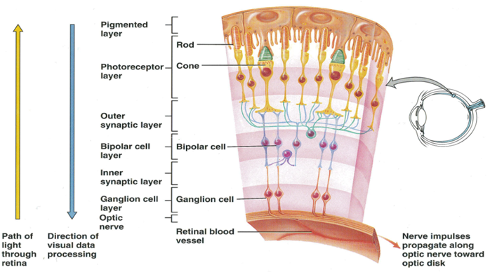

Slide 37
Mechanoreception
Mechanoreceptors
Detection of Mechanical Energy and Force
– Tactile (touch and pressure)
– Equilibrium (gravity and acceleration)
– Vibrations (sound)

Slide 38
Mechanoreception
Mechanoreceptors
Detection of Mechanical Energy and Force
– Tactile (touch and pressure)
– Equilibrium (gravity and acceleration)
– Vibrations (sound)

Slide 39


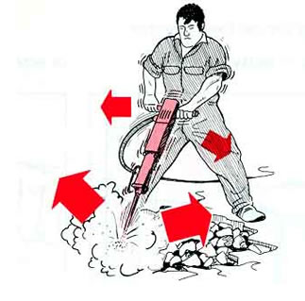

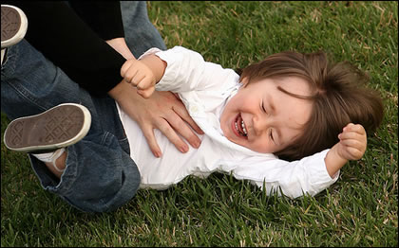
Tactile (Touch)
Touch is an important sense because it provides important information about:
Proximity of food
Predators
Environmental features
Tactile Sensations (Mechanoreceptors)
Touch, pressure, vibration
Detected by encapsulated nerve endings
Itch and tickle
Detected by free nerve endings

Slide 40
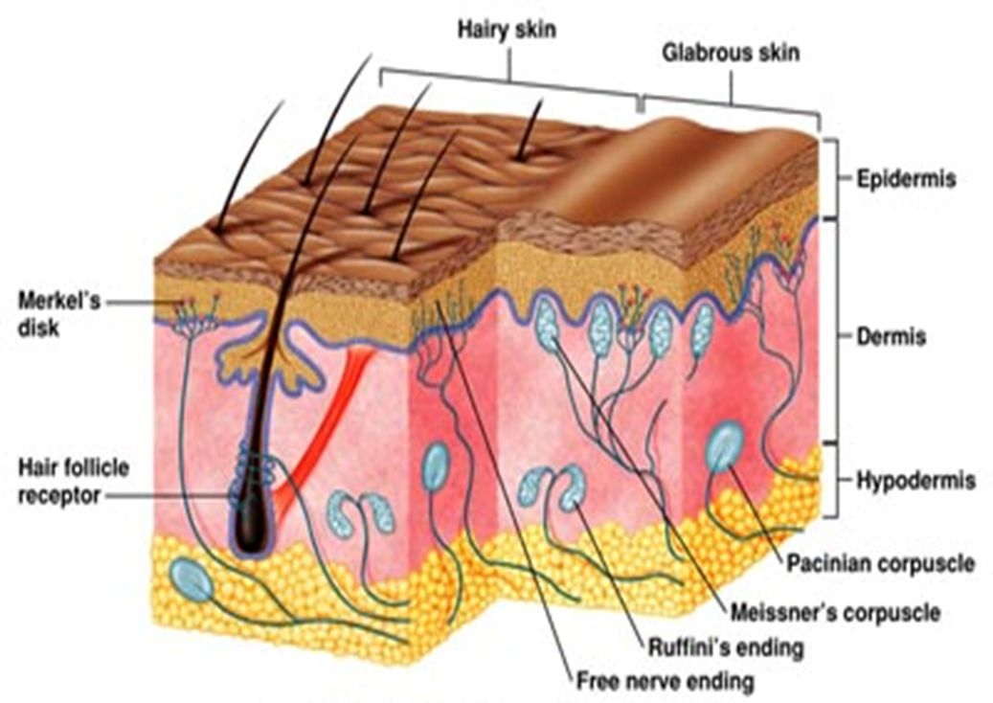
Sensory receptors in the skin and subcutaneous layer
Meissner corpuscles (Corpuscles of touch)
Pacinian corpuscles (Lamellated corpuscles)
Ruffini corpuscles (Type II cutaneous mechanoreceptors)
Merkel Disks (Type I cutaneous mechanoreceptors)
Hair Root Plexuses
Free nerve Endings

Slide 41
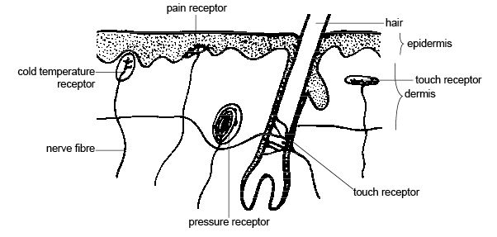
General senses in the skin
Pain Receptor
Cold Temperature Receptor
Touch Receptor
Touch Receptor
Pressure Receptor

Slide 42
Tactile Sensations (Mechanoreceptors)
Touch
Rapidly adapting touch receptors:
Corpuscles of touch (Meissner corpulses)
Hair root plexuses
Slowly adapting touch receptors:
Type I cutaneous mechanoreceptors (Merkel disks)
Type II cutaneous mechanoreceptors (Ruffini corpulses)
Pressure and Vibration
Pressure is a sustained sensation felt over a larger area than touch
Pressure receptors:: Type I mechanoreceptors and lamellated (pacinian) corpulses
Lower frequency vibrations: corpulses of touch
Higher frequency vibrations: lamellated corpulses
Itch and tickle
Itch sensations stimulated by stimulation of free nerve endings by certain chemicals like bradykinin, often a result of local inflammatory response
Notes:
Can you tickle yourself?
Why or why not?
Impulses are conducted to and from cerebellum when you are moving your fingers and touching yourself does not occur when someone else tickles you

Slide 43
Baroreceptors
Baroreceptors are specialized mechanoreceptors in the walls of blood vessels, to sense pressure changes by responding to change in the tension of the arterial wall.
Their function is to sense pressure changes by responding to change in the tension of the arterial wall. The baroreflex mechanism is a fast response to changes in blood pressure.
They are located on both arteries and veins.
Blood pressure is constantly monitored by baroreceptors, as they detect changes in your blood pressure.
If the blood pressure within the aorta or carotid sinus increases, the walls of the arteries stretch and stimulate increased activity within the baroreceptors.
They communicate to the brain whether blood pressure is too low or high, so that the brain can adjust the blood flow accordingly.

Slide 44
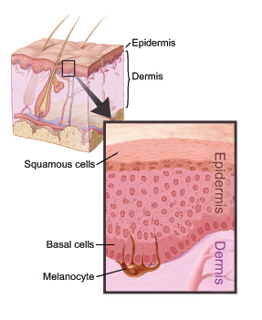
Thermoreceptors (Thermal Sensations )
Thermoreceptors: free nerve endings
Thermal sensations: coldness and warmth
Temperatures between 10° and 40°C (50-105°F)
activate cold receptors
located in the epidermis
Temperatures between 32° and 48°C (90- 118°F)
activate warm receptors
located in the dermis
Below 10°C and above 48°C stimulate
Nociceptors
produce painful sensations

Slide 45
Nociceptors (Painful Sensations)
Nociceptors: free nerve endings
Responds to damaging or potentially damaging stimuli by sending “possible threat” signals to the spinal cord and the brain
Five stimuli that can cause pain:
Excessive stimulus of sensory receptors
Bright light in your eyes
Excessive stretching of structure
Prolonged muscle contractions
Hold weight for a long time
Inadequate blood flow to organ
Certain chemical substances
Referred pain: pain felt in skin above or located near but not in organ
Fast pain: within 0.1 seconds of stimulus; acute, sharp, or prickling pain; localized not in deep tissue
Slow pain: begins a second or more after stimulus is applied; chronic burning, aching, throbbing; skin deep tissue and internal organs
Notes:
When you touch a doorknob (or something else made of metal), which has a positive charge with few electrons, the extra electrons want to jump from you to the knob. ... Static electricity happens more often during the colder seasons because the air is drier, and it's easier to build up electrons on the skin's surface.
Even the static electricity travels at light speed, which is 186, 282 miles per second!

Slide 46
Proprioceptors (Proprioceptive Sensations)
Inform you consciously and unconsciously of
Degree to which your muscles are contracted
Amount of tension present in your tendons
Positions of your joints
Orientation of your head
Receptors for these sensations called:
Proprioceptors and are located in:
Skeletal muscles, tendons, in and around synovial joints, and inside inner ear
They adapt slowly and only slightly
Kinesthesia: perception of body movements, allows you to walk, type, or dress without using your eyes

Slide 47
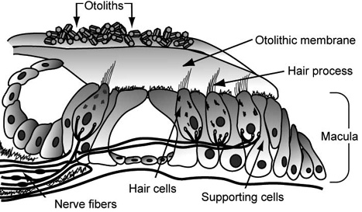
Equilibrium: Hair Cells
Proprioceptors: Located deep inside the ear
They tell you if your head is tilted or if you are standing on your head. (orientation relative to gravity)
Vibrations bend “hairs” (stereocilia)
Alters release of neurotransmitter to sensory neurons sent to the brain

Slide 48
Physiology of Equilibrium
Static Equilibrium
Maintenance of the position of the body relative to the force of gravity
Maintains posture and balance by providing sensory information on the position of the head
Dynamic Equilibrium
Maintenance of body position in response to sudden movements such as rotation, acceleration, and deceleration
Re-establish balance to disturbed equilibrium by regulating sensitivity of hair cells in the ear

Slide 49
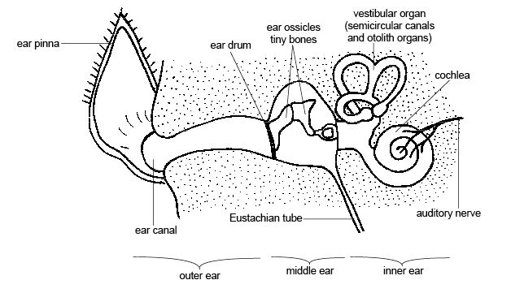
Vibration (Sound)
Vertebrate Cochlea
Elongate structure containing hair cells
Fluid pressure waves induce vibration of the basilar membrane
Stimulates hair cells which triggers electrical impulses to the brain.

Slide 50
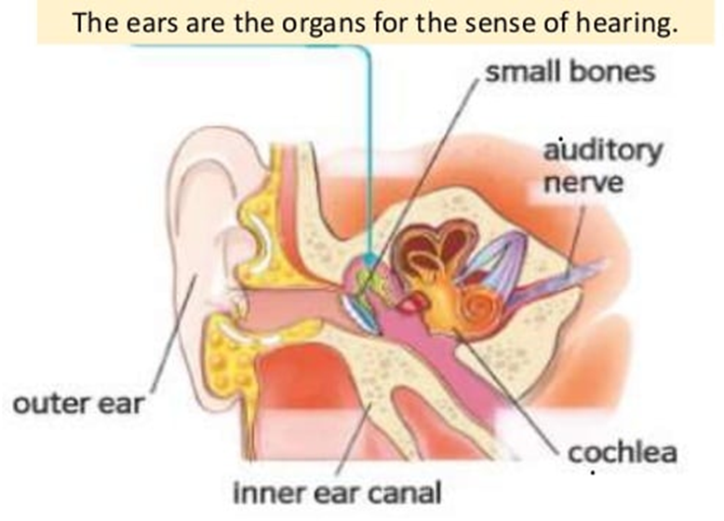
Sound: How do your ears work?
First the outer ear collects the sound waves then the sound enter the ear canal and cause the eardrum to vibrate.
Eardrum vibrations are carried through the hammer, anvil and stirrup of the ear to a fluid-filled structure called the cochlea.
Different pitches cause different parts of the fluid in the cochlea to vibrate.
When cochlear fluid vibrates, it moves hairs connected to nerve cells, which send signals to the brain through the auditory nerve.
The brain helps you recognize the sound.
Notes:
The hammer, anvil, and stirrup are the smallest bones found in the human body. They also can be called by their latin names: the malleus, incus, and stapes, respectively. Collectively they are called ossicles.
The cochlea is the part of the inner ear involved in hearing. It is a spiral-shaped cavity in the bony labyrinth, in humans making 2.75 turns around its axis, the modiolus. ... The name cochlea derives from Ancient Greek κοχλίας (kokhlias) 'spiral, snail shell'.

Slide 51
Sound: How many sensors do our ears have?
Thousands of neurons in your ears respond to sound.
These neurons respond differently to different pitches.
Pitches range from low (such as from drums) to high (such as from bells).
All these signals are sent individually to the auditory cortex in your brain.
The auditory cortex integrates all the frequencies correctly and helps your brain understand the sound (for example, music).
This is similar to how a microphone assembles all the signals of sound and relays it forward.
The neurons in your ear convert/transduce sound into electrical impulses, and send them along the auditory nerve (similar to wires) to the auditory cortex in your brain.

Slide 52
What is sound?
Oscillation of air pressure is felt by humans as sound.
When air is pushed repeatedly, as by a speaker diaphragm, it creates what we call a sound wave.
Sound is a mechanical wave: Your ears can detect these waves
Changes in air pressure (vibrations) produce the movement of air particles.
These particles start bumping into the other air particles, and this causes a wave that travels in all directions.
The mechanical energy in the wave is sensed by our ears and converted to electrical energy, which is transmitted to the auditory cortex, and our brain recognizes this as sound.

Slide 53
Passage of Sound through the Ear

Slide 54
REFERENCES
C.B. Powar, 2010.Cell Biology. 5th Ed, Himalyan Publishing House.
Jeremy M. Berg, John L. Tymoczko and Lubert Stryer. 2006. “Biochemistry,” 6th Ed. W.H. Freeman and Co. Ltd.
Robert Weaver. 2012 “Molecular Biology,” 5th Edition, MCGraw-Hill.
Jon Cooper, , 2004. “Biosensors A Practical Approach” Bellwether Books.
Martin Alexander, 1994 “Biodegradation and Bioremediation,” Academic Press.
D. Albe-Fessard et. al. Handbook of Sensory Physiology. DOI: 10.1007/978-3-642-65438-1; ISBN: 978-3-642-65440-4
https://www.ncbi.nlm.nih.gov/books/NBK547656/

Slide 55
THANK YOU

